Slide 1
CSE477
VLSI Digital Circuits
Fall 2002
Lecture 23: Semiconductor Memories
Mary Jane Irwin ( www.cse.psu.edu/~mji ) www.cse.psu.edu/~cg477
[Adapted from Rabaey’s Digital Integrated Circuits, ©2002, J. Rabaey et al.]

Slide 2
Review: Basic Building Blocks
Datapath
  Execution units
    Adder, multiplier, divider, shifter, etc.
  Register file and pipeline registers
  Multiplexers, decoders
Control
  Finite state machines (PLA, ROM, random logic)
Interconnect
  Switches, arbiters, buses
Memory
  Caches (SRAMs), TLBs, DRAMs, buffers

Slide 3
A Typical Memory Hierarchy
By taking advantage of the principle of locality:
  Present the user with as much memory as is available in the cheapest technology.
  Provide access at the speed offered by the fastest technology.
On-Chip Components
Control
eDRAM
Instr
Cache
Second
Level
Cache
(SRAM)
Secondary
Memory
(Disk)
ITLB
Main
Memory
(DRAM)
Datapath
RegFile
DTLB
Data
Cache
Speed (ns): .1’s 1’s 10’s 100’s 1,000’s
Size (bytes): 100’s K’s 10K’s M’s T’s
Cost: highest lowest
Notes:
Instead, the memory system of a modern computer consists of a series of black boxes ranging from the fastest to the slowest.
Besides variation in speed, these boxes also varies in size (smallest to biggest) and cost.
What makes this kind of arrangement work is one of the most important principle in computer design. The principle of locality.
The design goal is to present the user with as much memory as is available in the cheapest technology (points to the disk).
While by taking advantage of the principle of locality, we like to provide the user an average access speed that is very close to the speed that is offered by the fastest technology.
(We will go over this slide in detail in the next lectures on caches).

Slide 4
Semiconductor Memories
RWM |  | NVRWM | ROM
Random Access | Non-Random Access | EPROM | Mask-programmed
SRAM (cache, register file) | FIFO/LIFO | E²PROM
DRAM | Shift Register CAM | FLASH | Electrically-programmed (PROM)
Notes:
>50% of the transistors in a microprocessor are in the memory (reg file, caches, etc.) - #bits, #bytes, #words, #bits/word, #data ports (#inputs, #outputs)
RW – read write (as opposed to RO, read only)
NV – non volatile (holds data even when power is off) – ROM and FLASH
EPROM – erasable programmable; E2PROM – electrically erasable – write operations take substantially longer than reads

Slide 5
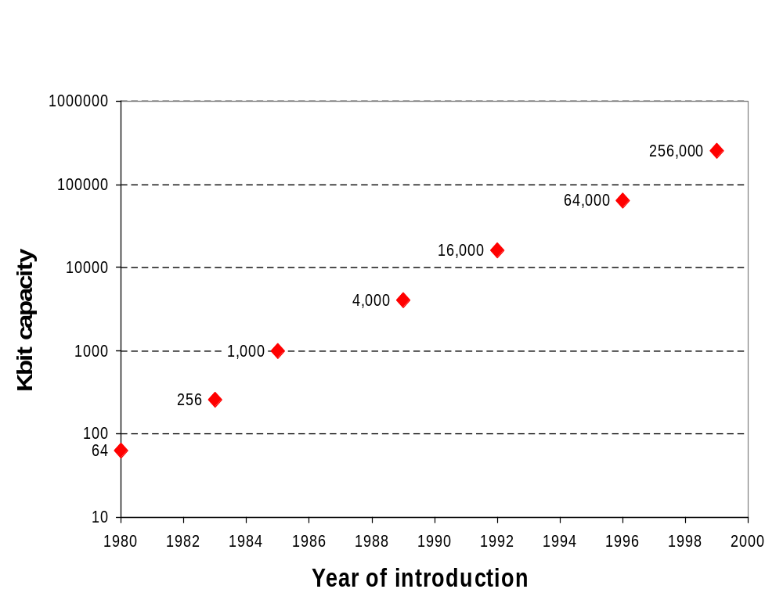
Growth in DRAM Chip Capacity

Slide 6
1D Memory Architecture
m bits
m bits
S₀
Word 0
S₀
Word 0
S₁
Word 1
S₁
Word 1
S₂
Word 2
Storage
Cell
A₀
S₂
Word 2
Storage
Cell
S₃
A₁
S₃
n words
Decoder
A_{k-1}
S_{n-2}
S_{n-2}
Word n-2
Word n-2
S_{n-1}
S_{n-1}
Word n-1
Word n-1
Input/Output
Input/Output
n words → n select signals
Decoder reduces # of inputs
k = log₂ n
Notes:
Only one select line active at a time. E.g., N= 10**6 = 2 **20 (1 Mword) means 1 million select signals
By adding decoder reduce number of inputs from 1 million to 20 (address lines). Note, still have to generate 1 million select lines with a very biggggg decoder (see last lecture)
Scheme on right, while reducing #inputs, leads to very tall and narrow memories (and very slow because of very long bit lines). Also very big (and slow) address decoder (good to try to pitch match between the deocder and the memory core).

Slide 7
2D Memory Architecture
2^{k-j}
bit line
word line
A_{j}
A_{j+1}
Row Address
Row Decoder
storage (RAM) cell
A_{k-1}
m2^{j}
Column Address
A₀
A₁
Column Decoder
selects appropriate word from memory row
A_{j-1}
Sense Amplifiers
amplifies bit line swing
Read/Write Circuits
Input/Output (m bits)
Notes:
Put multiple words in one memory row – splits the decoder into two decoders (row and column) and makes the memory core square reducing the length of the bit lines (but increasing the length of the word lines). The lsb part of the address goes into the column decoder (e.g., 6 bits so that 64 words are assigned to one row (with 32 bits per word gives 2**11 bit line pairs) leaving 14 bits for the row decoder (giving 2**14 word lines) for an not quite square array.
The RAM cell needs to be as compact and fast as possible since it is replicated thousands of times in the core array.
To speed things up, don’t force bit lines to swing from rail-to-rail so need sense amplifiers to restore the signal.
This scheme is good only for up to 64 Kb to 256 Kb. For bigger memories it is too SLOW because the word and bit lines are too long.

Slide 8
3D Memory Architecture
Row Addr
Column Addr
Block Addr
Input/Output (m bits)
Advantages:
1. Shorter word and/or bit lines
2. Block addr activates only 1 block saving power
Notes:
1M word memory with 32 bits/word – 2 bit block address; 6 bit column addr giving 2**11 bit line pairs; 12 bit row address giving 2**12 word lines for almost square memory arrays

Slide 9
Read Only Memories (ROMs)

Slide 10
Precharged MOS NOR ROM
V_{dd}
precharge
WL(0)
GND
WL(1)
WL(2)
GND
WL(3)
BL(0)
BL(1)
BL(2)
BL(3)
Notes:
For class handout.

Slide 11
Precharged MOS NOR ROM
V_{dd}
0
→ 1
precharge
WL(0)
GND
0
→ 1
WL(1)
WL(2)
GND
WL(3)
BL(0)
BL(1)
BL(2)
BL(3)
1 1 1 1
0 1 1 0
Notes:
For lecture.
Lots of ways to build them, this is just the structure of choice.
First precharge all bit lines to 1 (make sure all word lines are inactive (0) – can do with an enabled decoder), then activate appropriate word line, existing fets selectively discharge bit lines low. So, no fet means a 1 is stored, fet means a 0 is stored.
Note that there is only one pull down in series in the network so its fast!

Slide 12
MOS NOR ROM Layout
Metal1 on top of diffusion
WL(0)
GND (diffusion)
WL(1)
Basic cell
10λ x 7 λ
Metal1
Polysilicon
WL(2)
GND (diffusion)
WL(3)
BL(0)
BL(1)
BL(2)
BL(3)
Only 1 layer (contact mask) is used to program memory array, so programming of the ROM can be delayed to one of the last process steps.
Notes:
Selective addition of metal to diffusion – add contacts to “program”
Note that ground is run in diffusion (not great) and is connected to a verticle diffusion run underneath the m1 strip.
A large part of the cell is devoted to the bit line contact and the ground connection.
Pull-down fets are 4/2 transistors

Slide 13
Transient Model for NOR ROM
precharge
metal1
r_{word}
BL
poly
WL
C_{bit}
c_{word}
Word line parasitics
Resistance/cell: 35Ω
Wire capacitance/cell: 0.65 fF
Gate capacitance/cell: 5.10 fF
Bit line parasitics
Resistance/cell: 0.15Ω
Wire capacitance/cell: 0.83 fF
Drain capacitance/cell: 2.60 fF
Notes:
Transient response – time from word line activation to bit line traversing voltage swing (typically 10% of Vdd). Note, values are for the old technology (in particular 5V Vdd)
These numbers are from the older (0.8 micron) technology.

Slide 14
Propagation Delay of NOR ROM
Word line delay
  Delay of a distributed rc-line containing M cells
  t_{word} = 0.38(r_{word} x c_{word}) M²
  = 20 nsec for M = 512
Bit line delay
  Assuming min size pull-down and 3*min size pull-up with reduced swing bit lines (5V to 2.5V)
  C_{bit} = 1.7 pF and I_{avHL} = 0.36 mA so
  t_{HL} = t_{LH} = 5.9 nsec
Notes:
word line delay is factor of M**2 – quadratic term (since no buffers in word line) so that tword = 0.38 (35 ohms x (0.65 + 5.1) fF) 512**2 = 20 nsec
bit line delay (2.4/1.2 pull-down and 8/1.2 pull-up), Cbit = 512 x (2.6 + 0.8) fF = 1.7 pF
tHL = (1.7 pF x 1.25V)/0.36 mA = 5.9 nsec
Note that the word line is by far the slowest, mostly due to the larger resistance/cell and the low swing on the bit lines

Slide 15
Read-Write Memories (RAMs)
Static – SRAM
  data is stored as long as supply is applied
  large cells (6 fets/cell) – so fewer bits/chip
  fast – so used where speed is important (e.g., caches)
  differential outputs (output BL and !BL)
  use sense amps for performance
  compatible with CMOS technology
Dynamic – DRAM
  periodic refresh required
  small cells (1 to 3 fets/cell) – so more bits/chip
  slower – so used for main memories
  single ended output (output BL only)
  need sense amps for correct operation
  not typically compatible with CMOS technology

Slide 16
Memory Timing Definitions
Read Cycle
Read
Read Access
Read Access
Write Cycle
Write
Write Setup
Write Hold
Data
Data Valid

Slide 17
4x4 SRAM Memory
read precharge
2 bit words
bit line precharge
enable
WL[0]
!BL
BL
A₁
WL[1]
Row Decoder
A₂
WL[2]
WL[3]
A₀
Column Decoder
clocking and control
sense amplifiers
BL[i]
BL[I+1]
write circuitry
Notes:
To decrease the bit line delay for reads – use low swing bit lines, i.e., bit lines don’t swing rail-to-rail, but precharge to Vdd (as 1) and discharge to Vdd – 10%Vdd (as 0). (So for 2.5V Vdd, 0 is 2.25V.) Requires sense amplifiers to restore to full swing.
Write circuitry – receives full swing from sense amps – or writes full swing to the bit lines

Slide 18
2D Memory Configuration
Sense Amps
Row Decoder
Sense Amps
Notes:
In reality, memory is designed in quadrants (hence the 4x growth every generation). This configuration halfs the length of the word and bit lines (for increased speed).

Slide 19
Decreasing Word Line Delay
Drive the word line from both sides
driver
driver
polysilicon word line
WL
metal word line
Use a metal bypass
polysilicon word line
WL
metal bypass
Use silicides
Notes:
driving from both sides reduces the worst case delay of the word line by 4 (like buffer insertion to reduce RC delay)

Slide 20
Decreasing Bit Line Delay (and Energy)
Reduce the bit line voltage swing
  need sense amp for each column to sense/restore signal
Isolate memory cells from the bit lines after sensing (to prevent the cells from changing the bit line voltage further) - pulsed word line
  generation of word line pulses very critical
    too short - sense amp operation may fail
    too long - power efficiency degraded (because bit line swing size depends on duration of the word line pulse)
  use feedback signal from bit lines
Isolate sense amps from bit lines after sensing (to prevent bit lines from having large voltage swings) - bit line isolation

Slide 21
Pulsed Word Line Feedback Signal
Read
Word line
Bit lines
Dummy
bit lines
Complete
10%
populated
Dummy column
  height set to 10% of a regular column and its cells are tied to a fixed value
  capacitance is only 10% of a regular column

Slide 22
Pulsed Word Line Timing
Read
Dummy bit lines have reached full swing and trigger pulse shut off when regular bit lines reach 10% swing
Complete
Word line
Bit line
ΔV = 0.1V_{dd}
Dummy bit line
ΔV = V_{dd}

Slide 23
Bit Line Isolation
bit lines
ΔV = 0.1V_{dd}
isolate
Read
sense
amplifier
sense
ΔV = V_{dd}
sense amplifier outputs

Slide 24
6-transistor SRAM Cell
WL
M2
M4
Q
M6
M5
!Q
M1
M3
!BL
BL
Notes:
Note that it is identical to the register cell from static sequential circuit - cross-coupled inverters
Consumes power only when switching - no standby power (other than leakage) is consumed
The major job of the pullups is to replenish loss due to leakage
Sizing of the transistors is critical

Slide 25
Next Lecture and Reminders
Next lecture
  SRAM, DRAM, and CAM cores
    Reading assignment – Rabaey, et al, 12.2.2-12.2.3
Reminders
  Project final reports due December 5th
  Final grading negotiations/correction (except for the final exam) must be concluded by December 10th
  Final exam scheduled
    Monday, December 16th from 10:10 to noon in 118 and 121 Thomas

